Slide 1
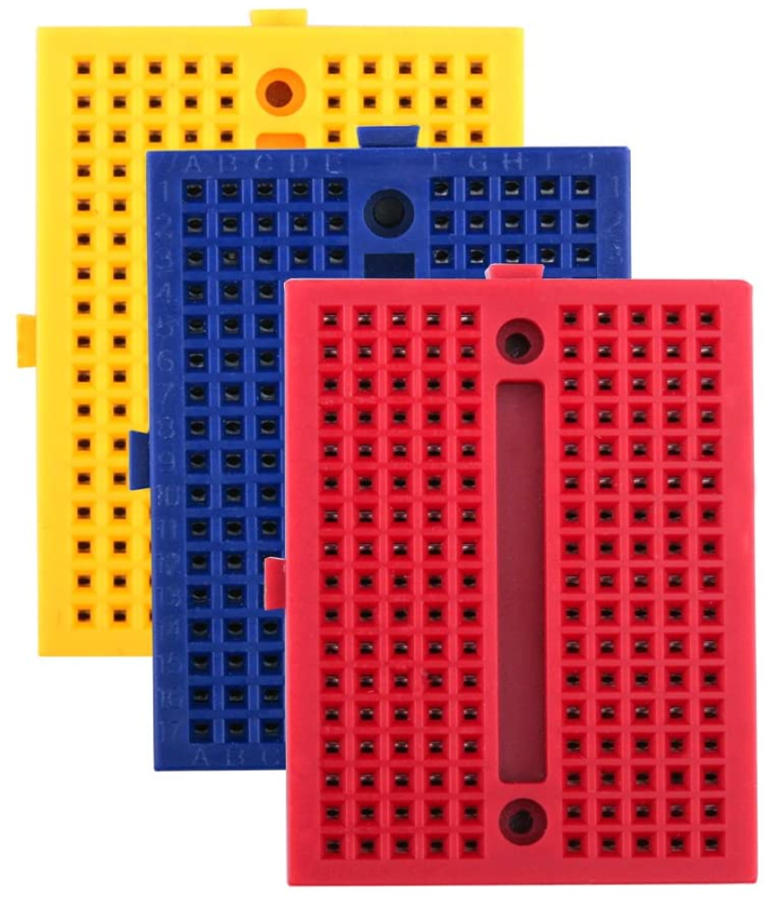
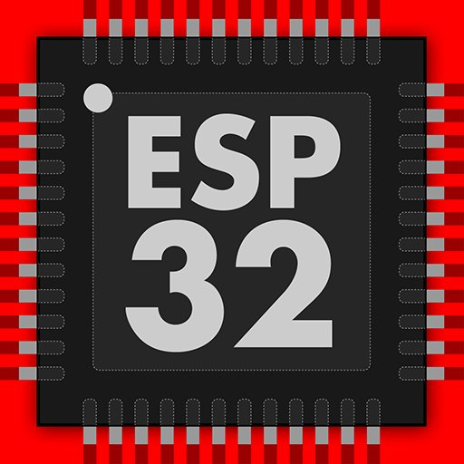
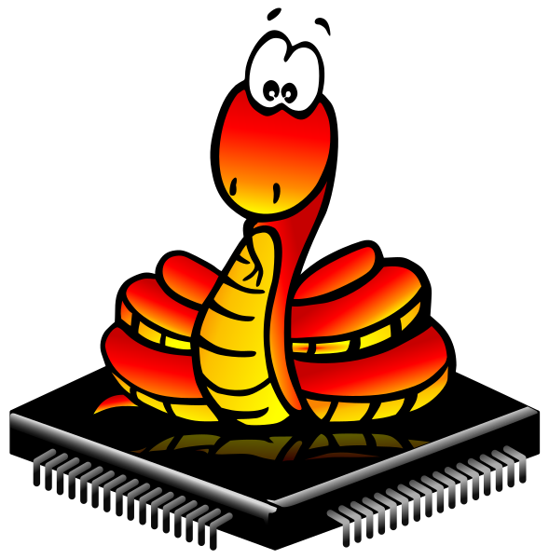
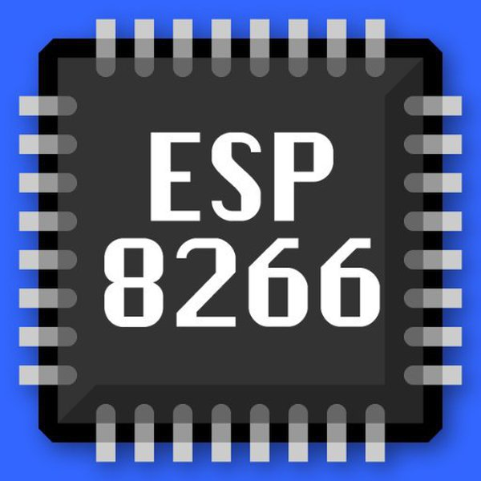

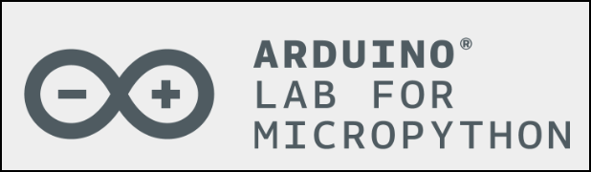
Module 1. MicroPython Basic
MicroPython + NodeMCU-ESP32S
safyzan salim
019 622 0575
IoT with ESP32 Training|Rev01-SEPT2023|

Slide 2
MicroPython + NodeMCU-ESP32S
Theoretically:
√ To run Python code on an ESP32 microcontroller, you need to flash ESP32’s MicroPython firmware.
√ MicroPyton ports Python 3.x, designed to run on microcontrollers, small embedded systems and is tailored for resource-constrained environments like the ESP32.
√ Link to download ESP32’s MicroPython firmware:
https://micropython.org/download/ESP32_GENERIC/
√ Python IDE: Thonny IDE
https://thonny.org/
Rev01 Sept2023

Slide 3
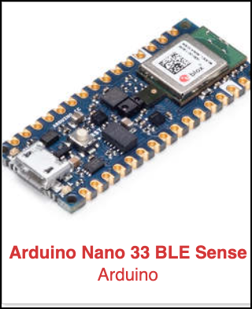
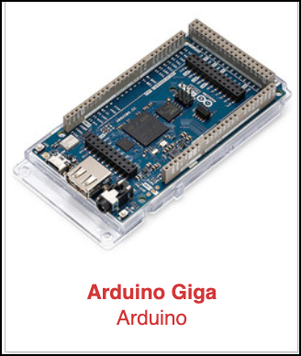
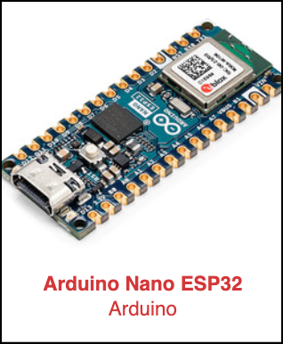
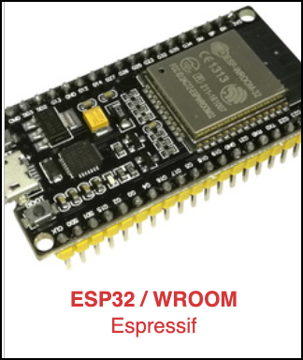
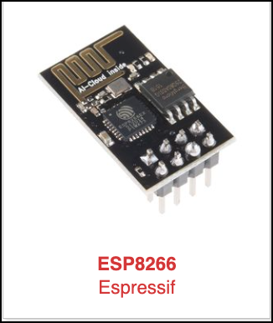
MicroPython + NodeMCU-ESP32S
Listed are Arduino families that can be used for MicroPython:
>> Do refer at this link for further details: https://micropython.org/download/
Rev01 Sept2023

Slide 4
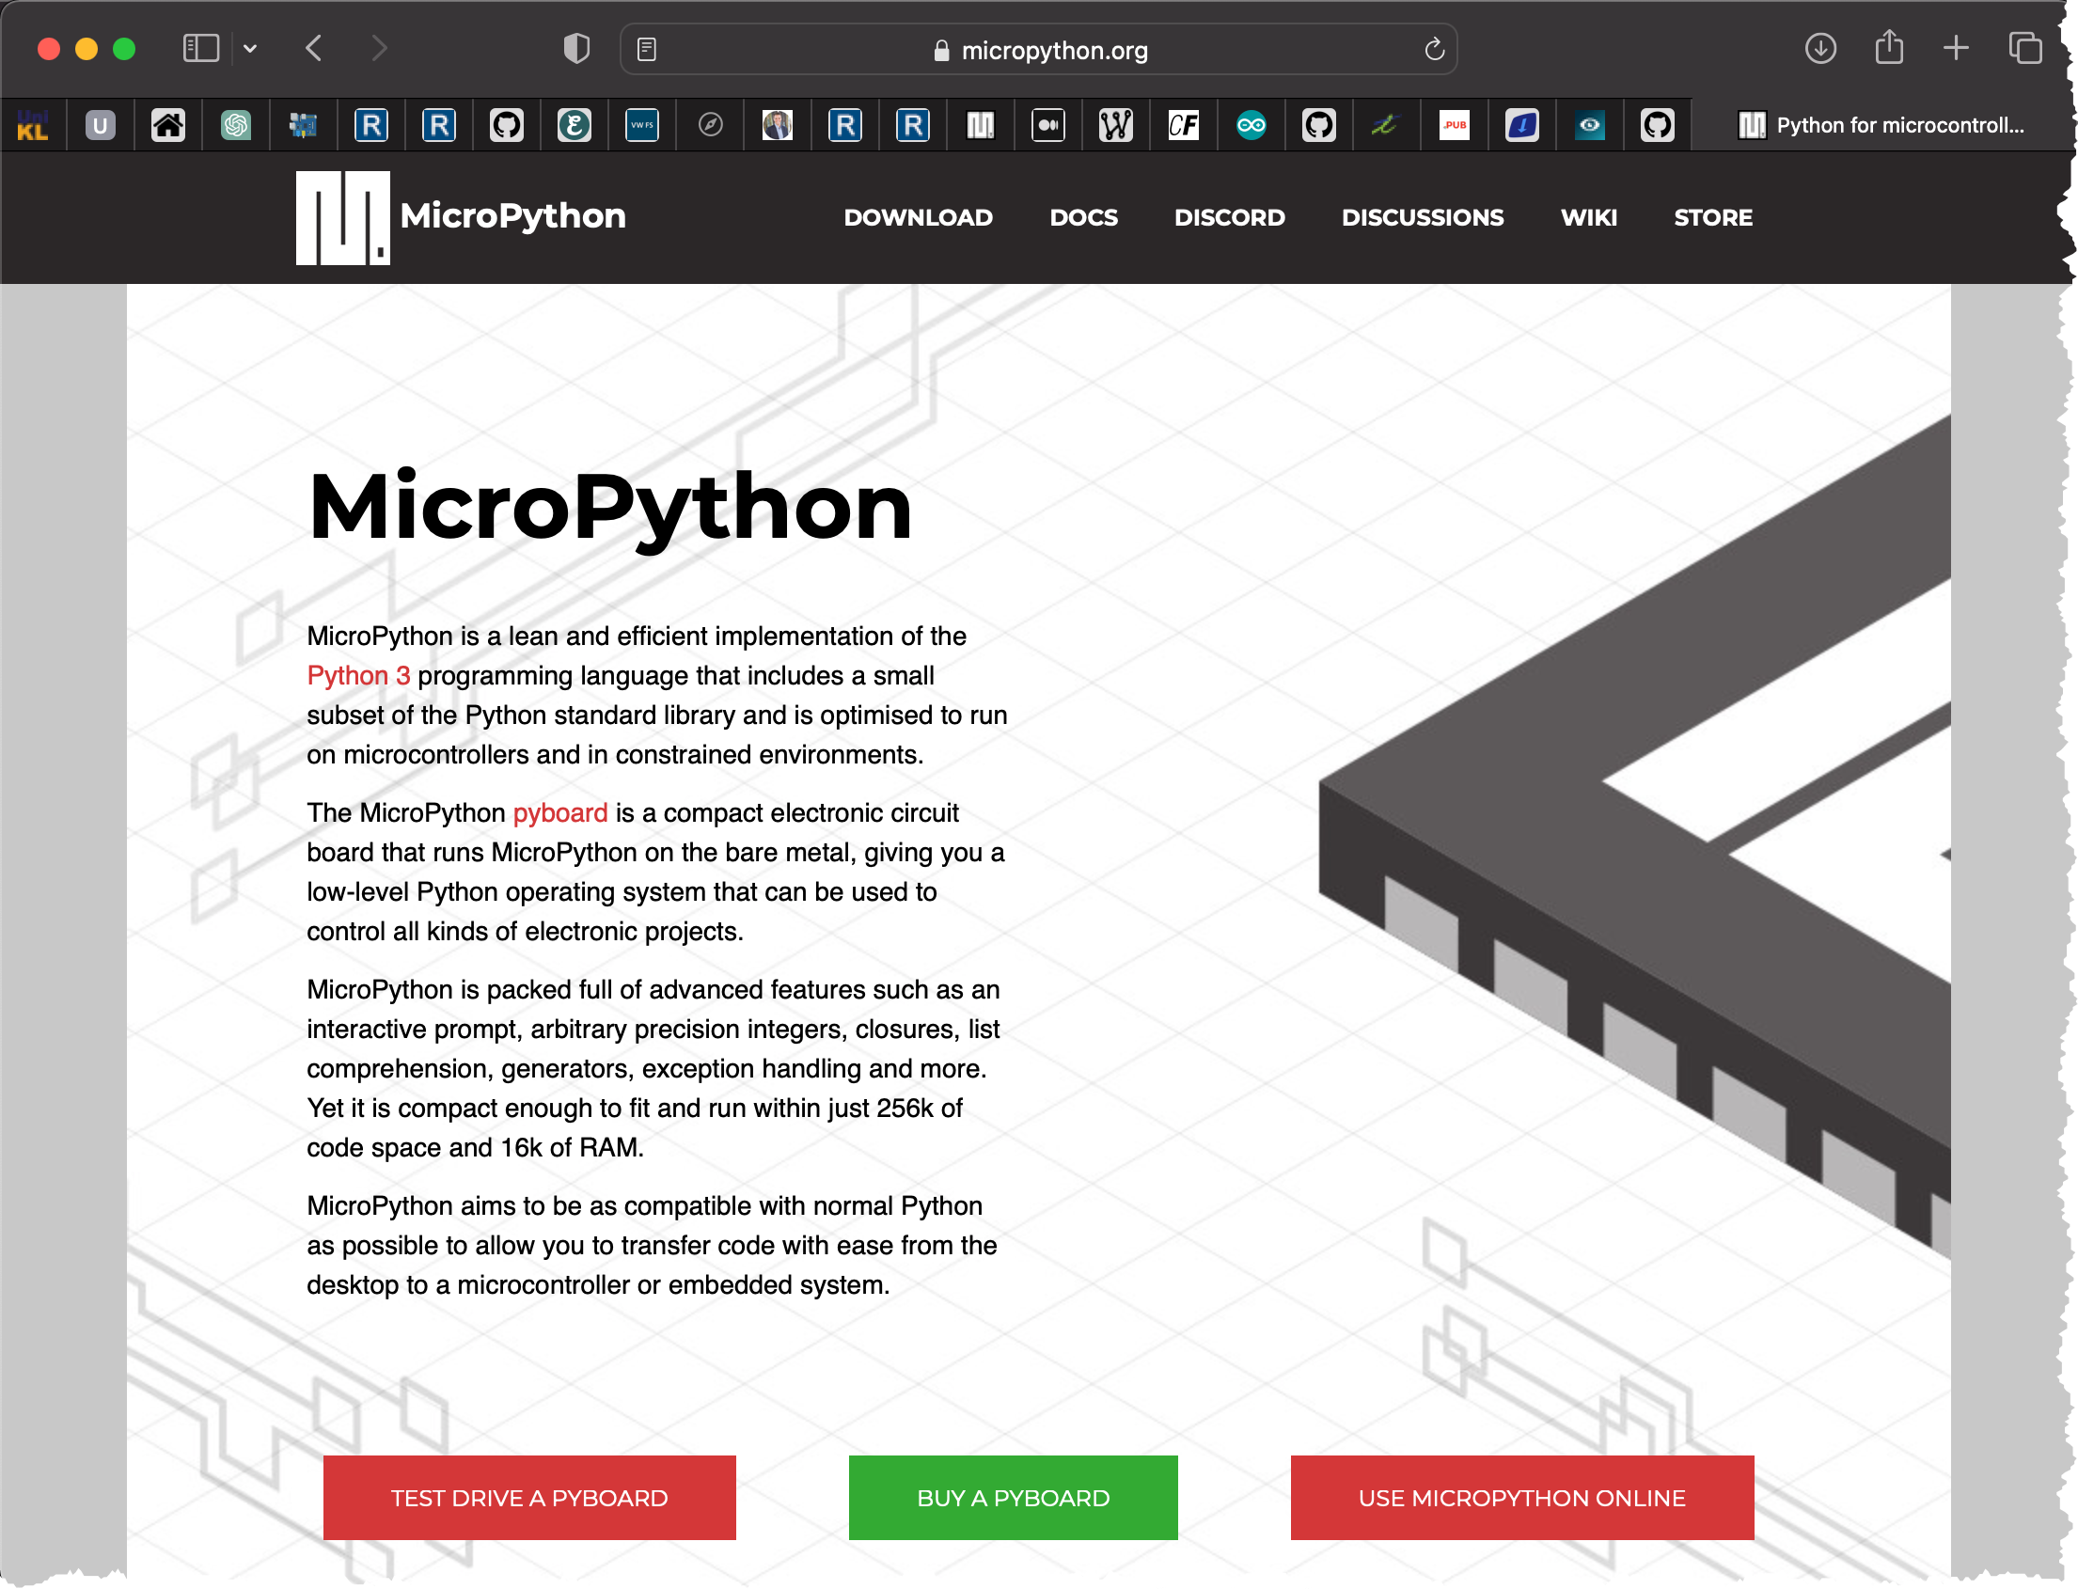
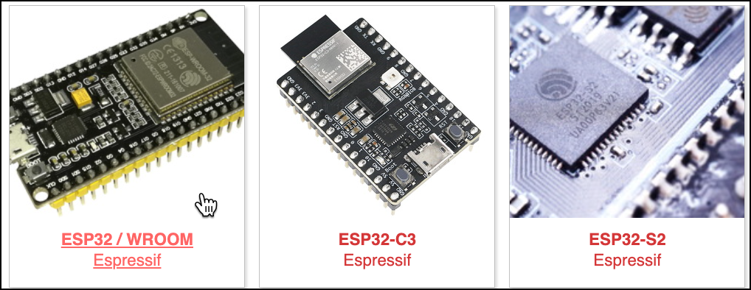
MicroPython + NodeMCU-ESP32S
1. Downloading MicroPython Firmware.
Download from https://micropython.org/download
Select the appropriate board.
Rev01 Sept2023

Slide 5
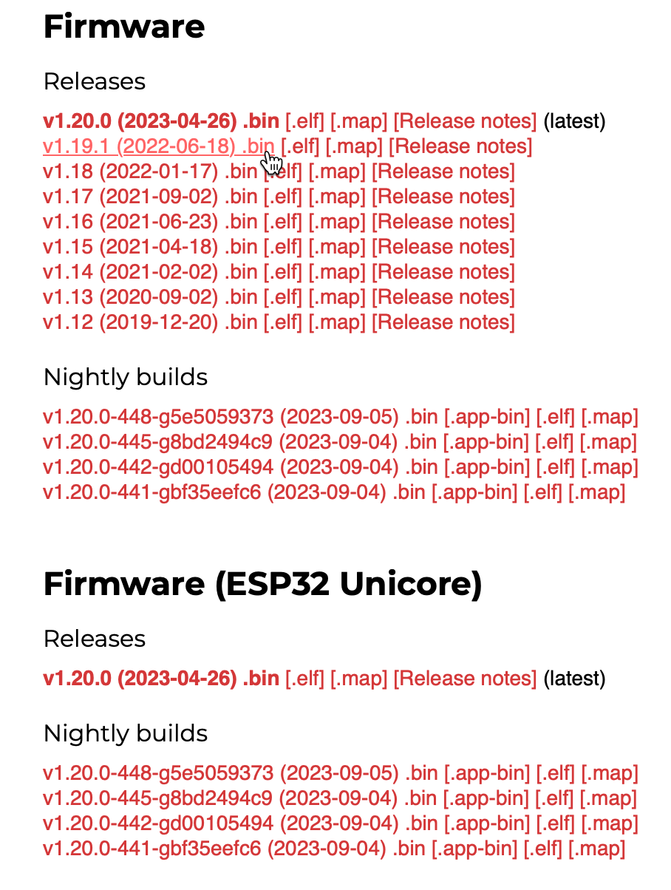

MicroPython + NodeMCU-ESP32S
1. Downloading MicroPython Firmware.
Choose any dot bin version releases firmware.
Nightly builds are unstable with fresh features and bugs not thoroughly tested.
Normally, select one or two version lower from the recent version.
e.g.: v1.19.1(2022-06-18).bin
Rev01 Sept2023

Slide 6
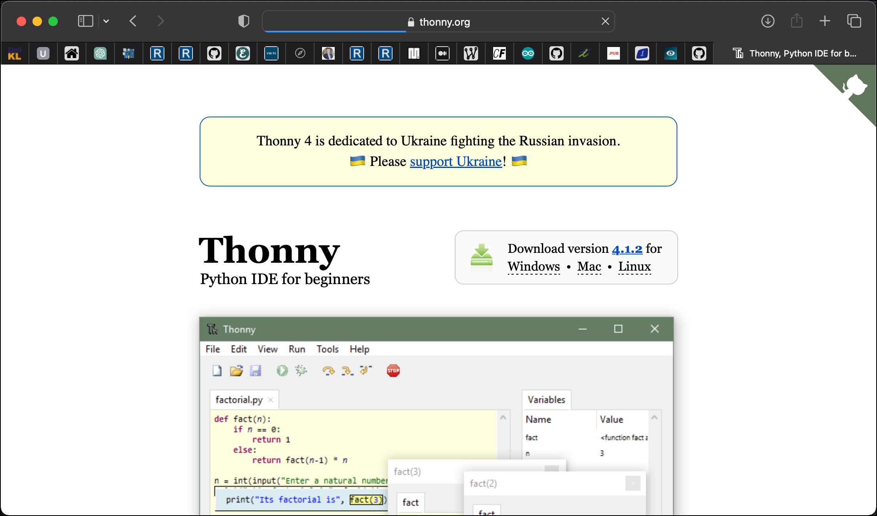
MicroPython + NodeMCU-ESP32S
2. Thonny Python IDE: Download & Install
Download from https://thonny.org/
Thonny is a beginner friendly Python IDE.
To erase & flush new firmware to ESP32S with the help of ESP tool.
Act as Python editor.
Rev01 Sept2023

Slide 7

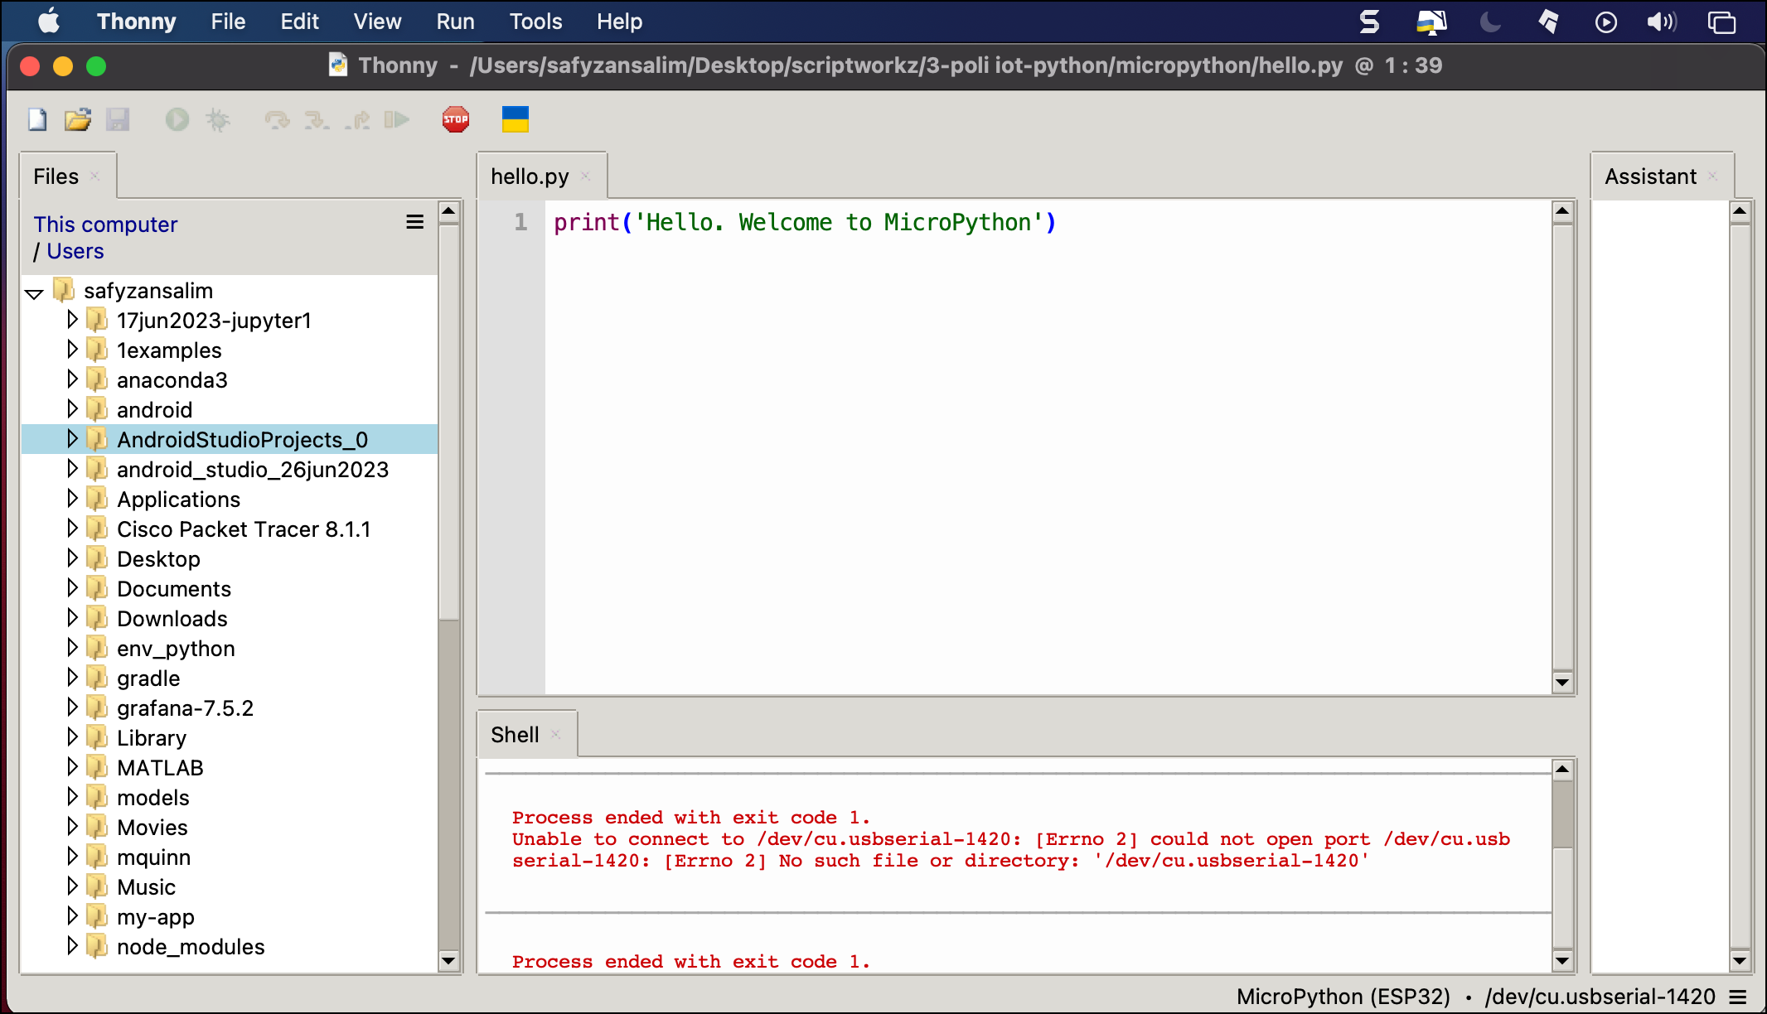
MicroPython + NodeMCU-ESP32S
2. Thonny Python IDE: Run Thonny
Rev01 Sept2023

Slide 8
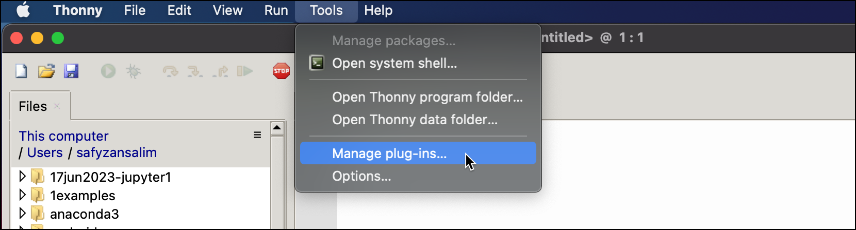
MicroPython + NodeMCU-ESP32S
2. Thonny Python IDE: Flushing New ESP32 Firmware.
Install plug-ins first.
Tools > Manage plug-ins.
Connect the ESP32S to your system.
Rev01 Sept2023

Slide 9
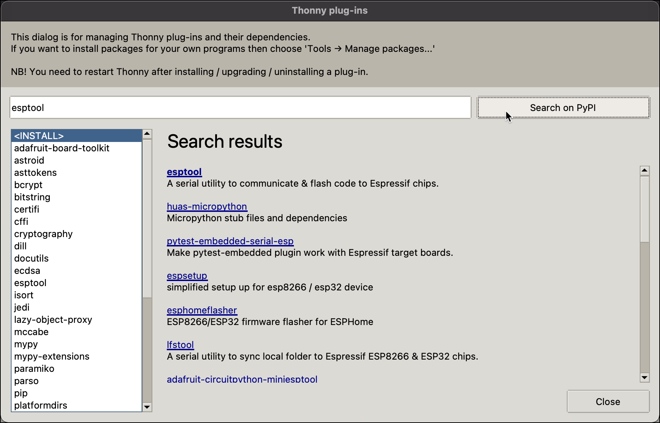
MicroPython + NodeMCU-ESP32S
2. Thonny Python IDE: Flushing New ESP32 Firmware.
Type esptool & click Search on PyPi button.
Click esptool to install.
Rev01 Sept2023

Slide 10
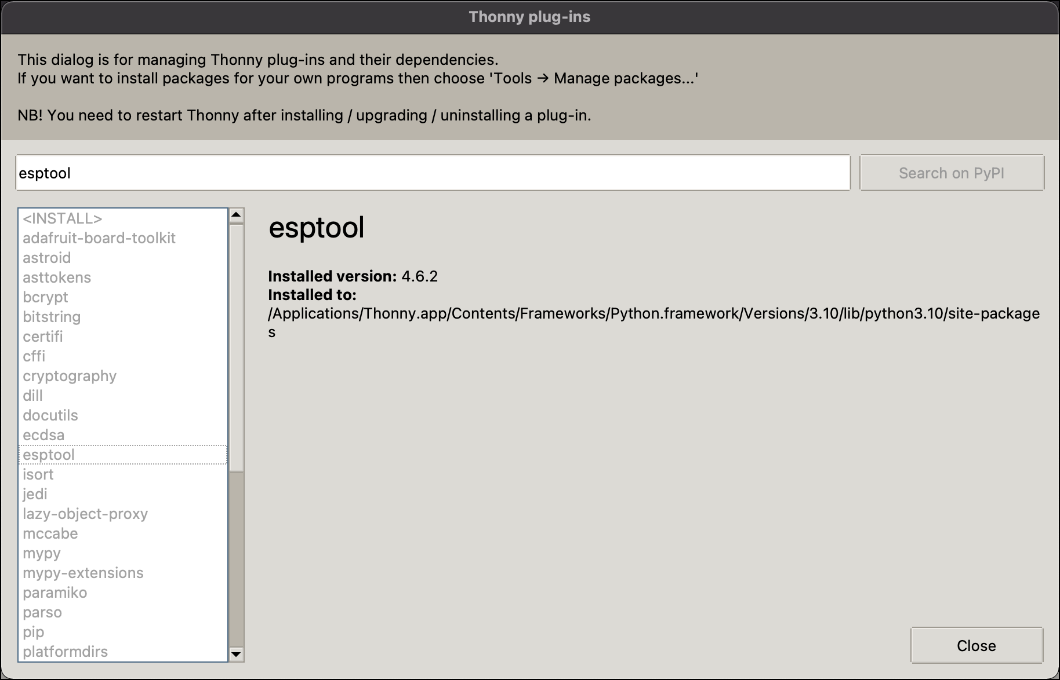
MicroPython + NodeMCU-ESP32S
2. Thonny Python IDE: Flushing New ESP32 Firmware.
esptool installed.
Rev01 Sept2023

Slide 11
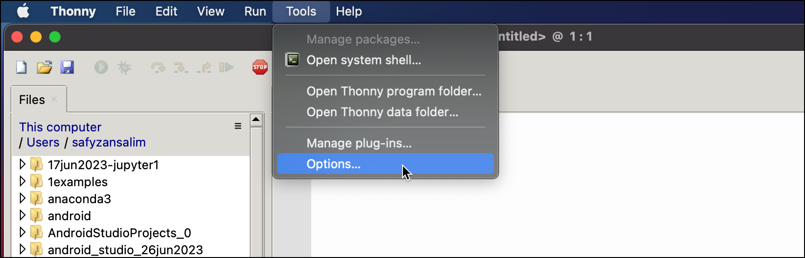
MicroPython + NodeMCU-ESP32S
2. Thonny Python IDE: Flushing New ESP32 Firmware.
To install Firmware.
Tools > Options
Rev01 Sept2023

Slide 12
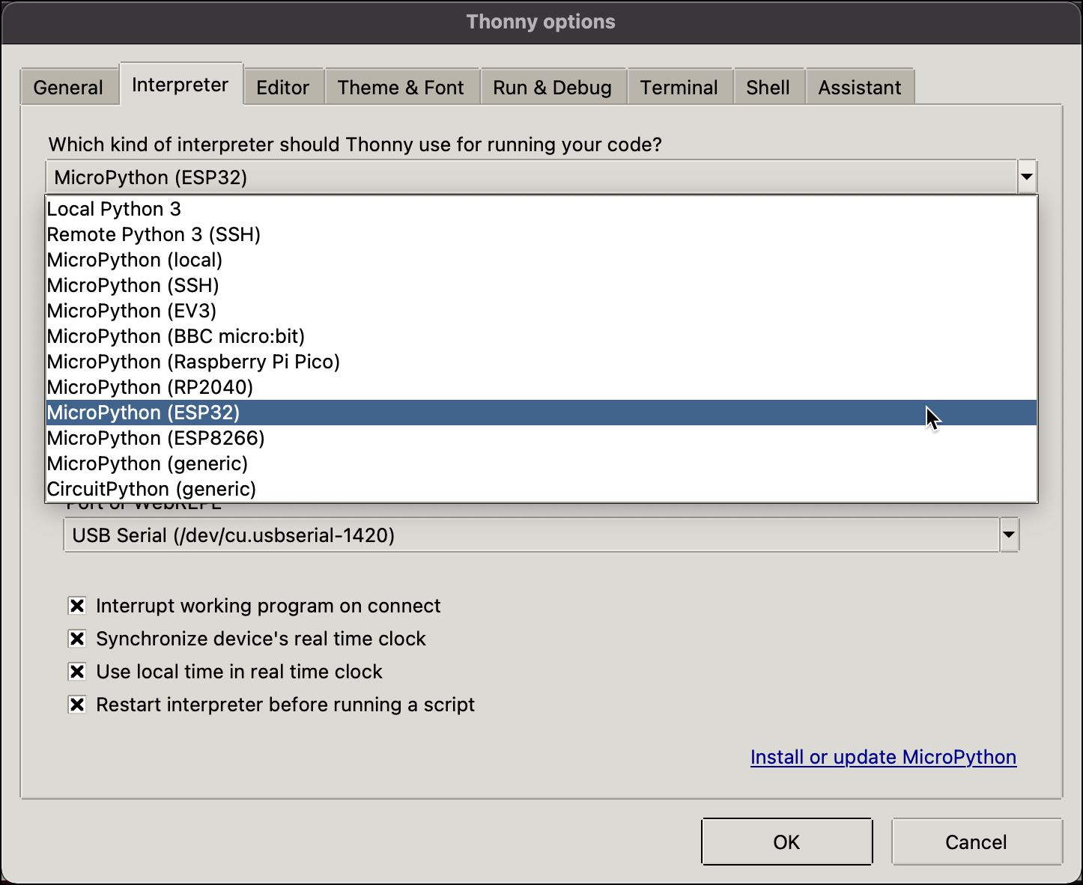
MicroPython + NodeMCU-ESP32S
2. Thonny Python IDE: Flushing New ESP32 Firmware.
Go to Interpreter tab.
Select MicroPython (ESP32).
Rev01 Sept2023

Slide 13
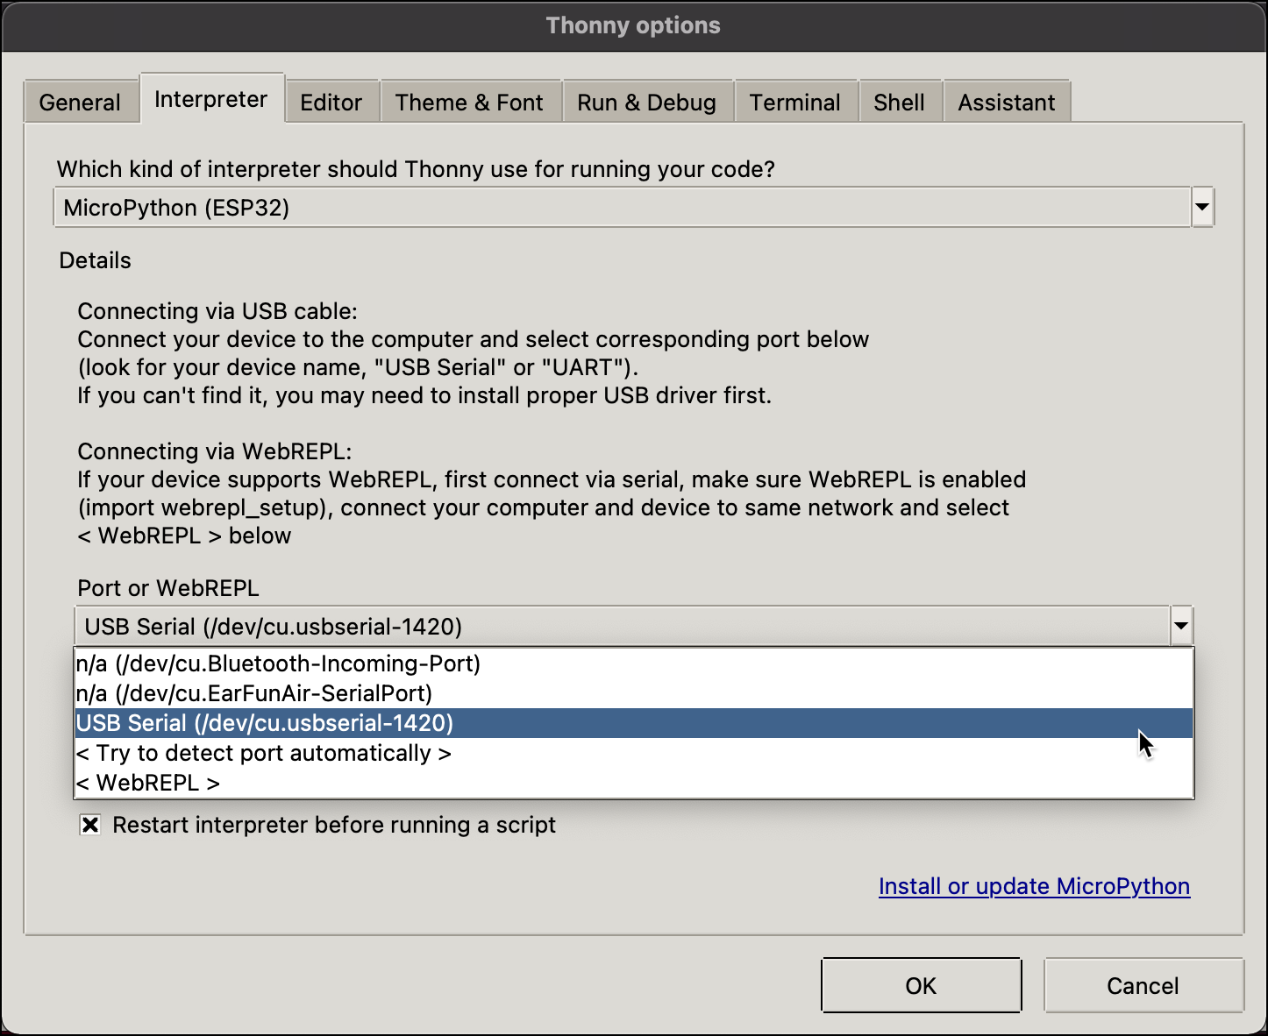
MicroPython + NodeMCU-ESP32S
2. Thonny Python IDE: Flushing New ESP32S Firmware.
Port: Choose the appropriate comm port of your ESP32S.
If port not detected, check your ESP32S connection to your laptop/PC.
Rev01 Sept2023

Slide 14
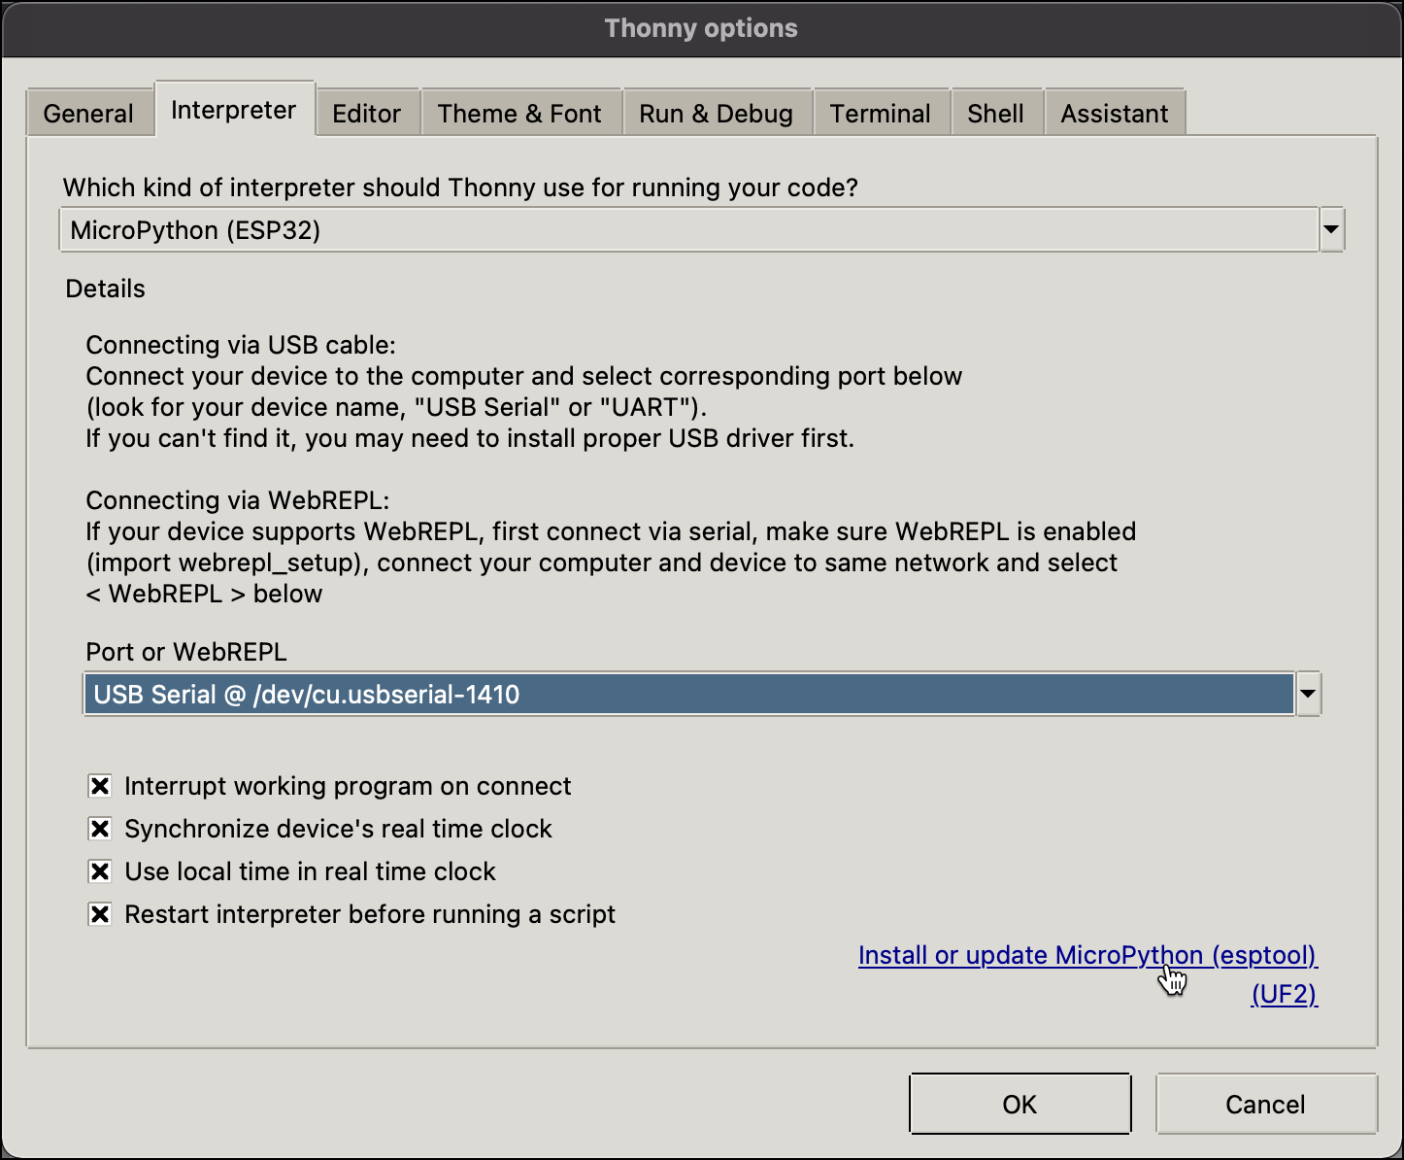
MicroPython + NodeMCU-ESP32S
2. Thonny Python IDE: Flushing New ESP32 Firmware.
Click Install or Update Micropython link.
Rev01 Sept2023

Slide 15
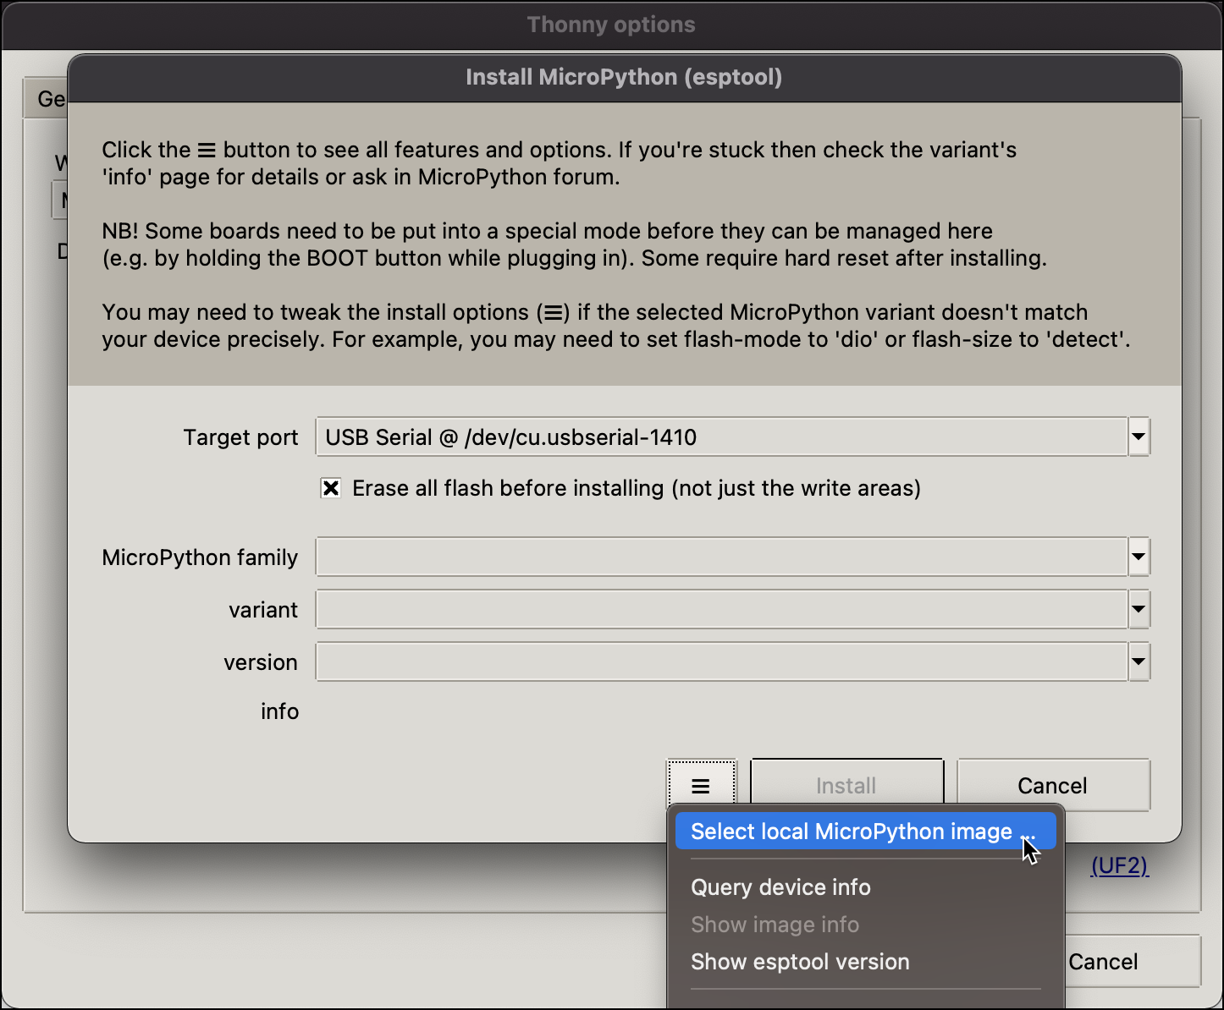
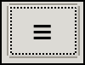
MicroPython + NodeMCU-ESP32S
2. Thonny Python IDE: Flushing New ESP32S Firmware.
Target Port: Which port the EPS32S is connected.
: browse the downloaded dot bin file from micropython.org.
Ensure that the Erase flash before installing is checked.
Rev01 Sept2023

Slide 16
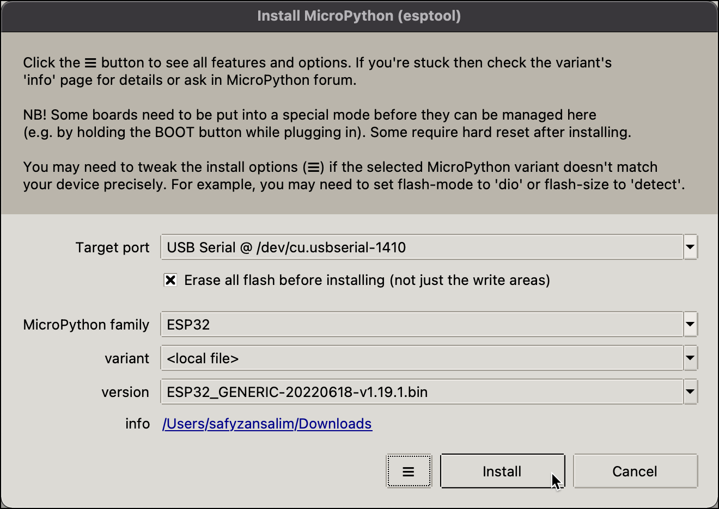
MicroPython + NodeMCU-ESP32S
2. Thonny Python IDE: Flushing New ESP32S Firmware.
Proceed with clicking Install button.
Rev01 Sept2023

Slide 17
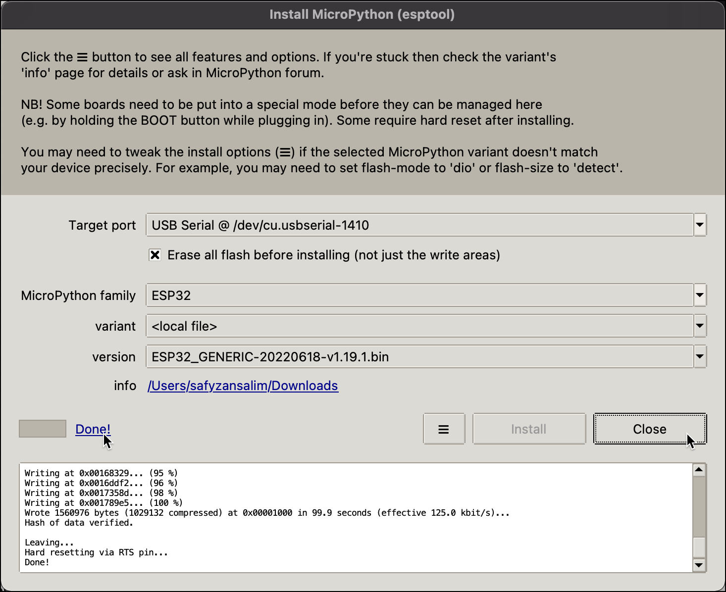
MicroPython + NodeMCU-ESP32S
2. Thonny Python IDE: Flushing New ESP32S Firmware.
Click Done! to view detail installation.
Click Close button to go to previous page.
Rev01 Sept2023

Slide 18
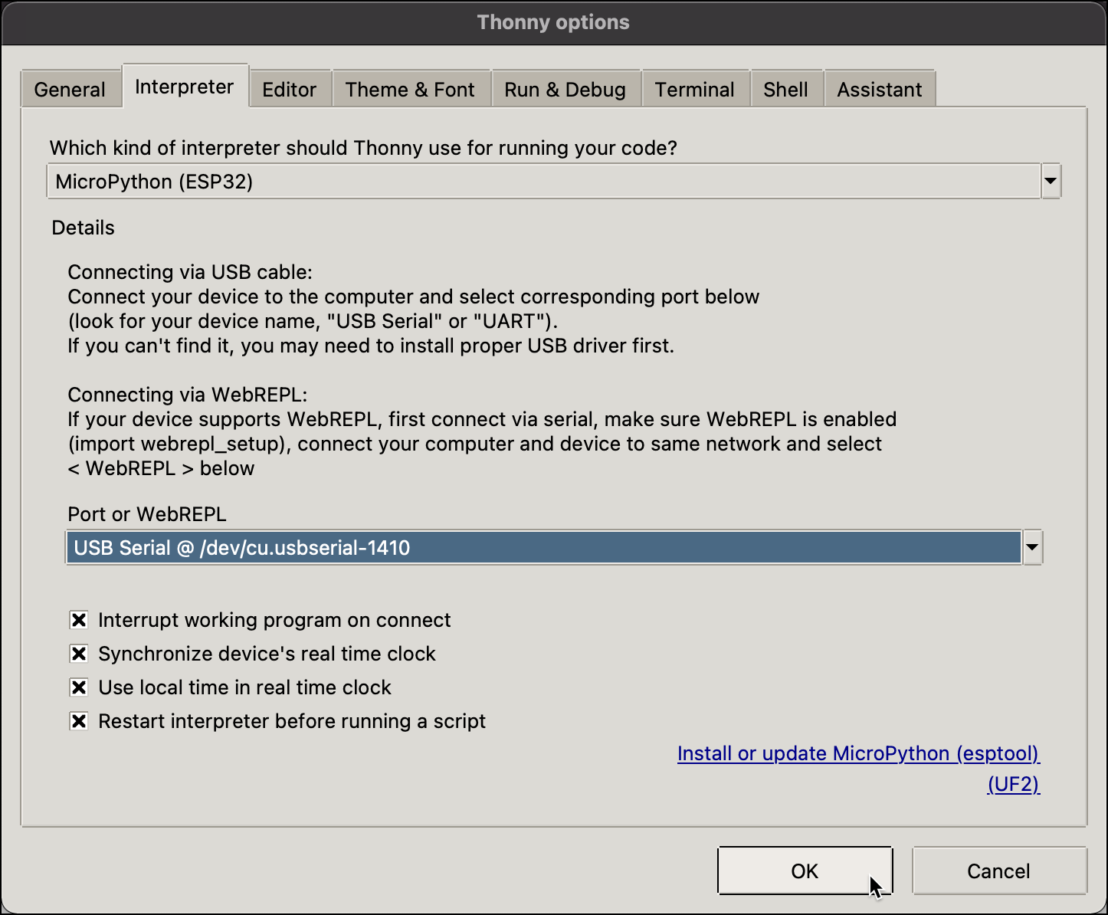
MicroPython + NodeMCU-ESP32S
2. Thonny Python IDE: Flushing New ESP32S Firmware.
Click OK button upon complete installation.
Rev01 Sept2023

Slide 19
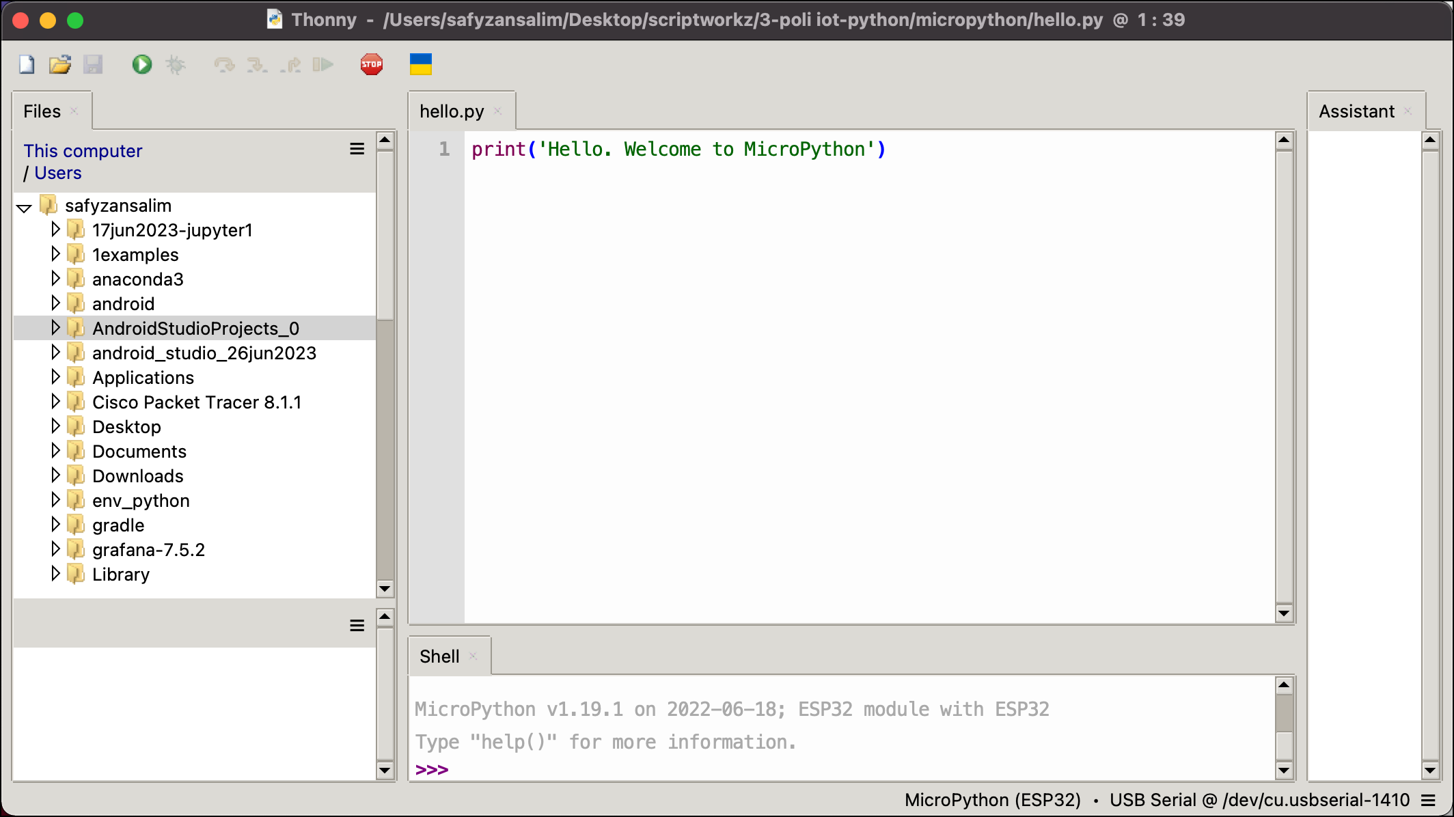
MicroPython + NodeMCU-ESP32S
2. Thonny Python IDE: Flushing New ESP32S Firmware.
Scripts that type at Shell, will respond immediately at ESP32.
To stop click Stop button at the top.
Click Run button to resume operation.
Rev01 Sept2023

Slide 20
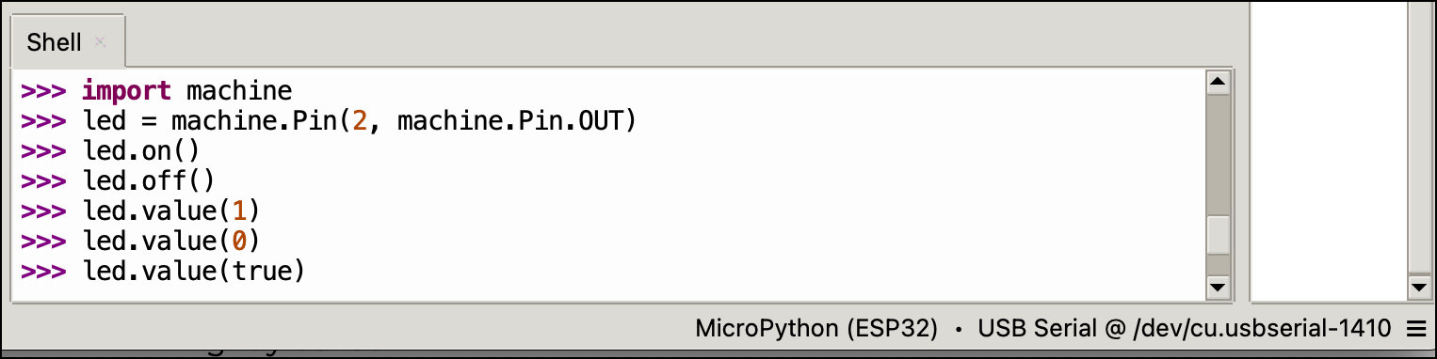
MicroPython + NodeMCU-ESP32S
2. Thonny Python IDE: Point to Shell tab
import machine
led = machine.Pin(2, machine.Pin.OUT)
led.on()
led.off()
led.value(1)
led.value(0)
led.value(true)
led.value(false)
Type the Python script line by line & press enter.
Please refer to ESP32S & observe the output .
Rev01 Sept2023

Slide 21
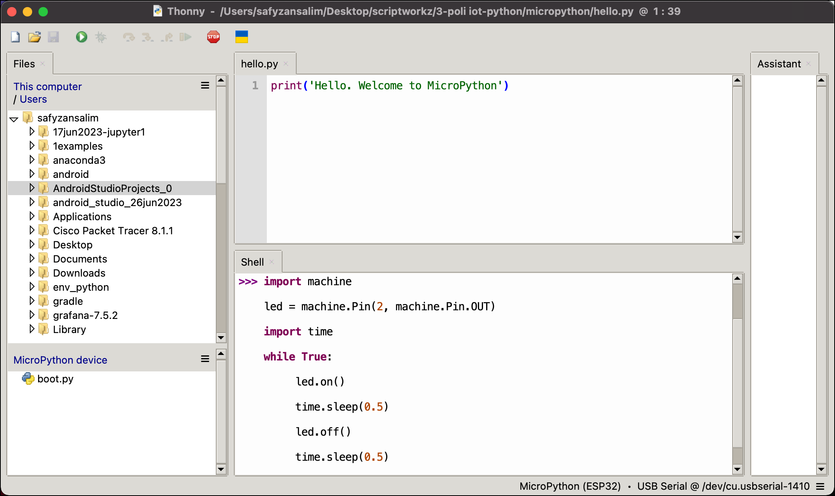

MicroPython + NodeMCU-ESP32S
2. Thonny Python IDE: Point to Shell Tab or A Tab
import machine
led = machine.Pin(2, machine.Pin.OUT)
import time
while True:
led.on()
time.sleep(0.5)
led.off()
time.sleep(0.5)
Type at A if you wish to save the file
A
New
Run Current Script
Open
Stop / Restart
Rev01 Sept2023

Slide 22
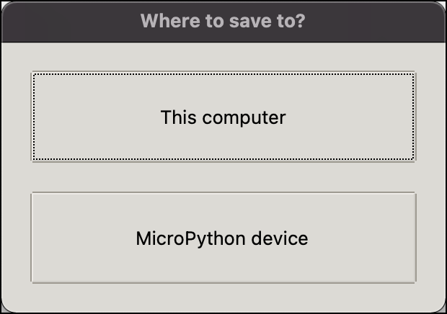
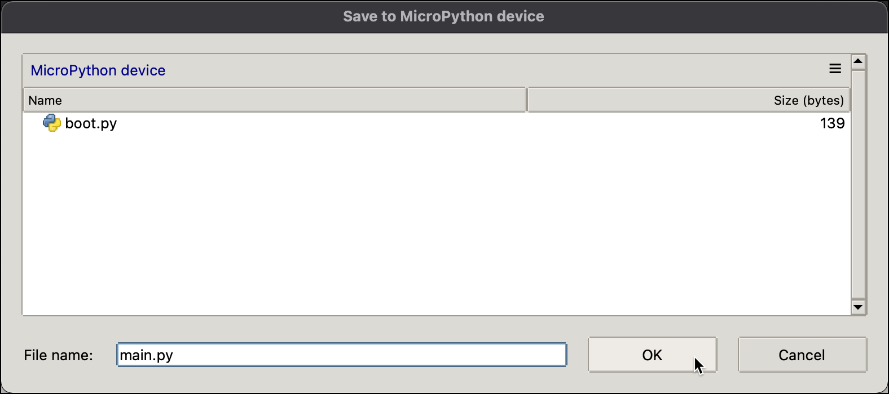
MicroPython + NodeMCU-ESP32S
2. Thonny Python IDE: Saving Your Works
You have two options to save your file: This computer or MicroPython device.
Name you file as main.py if you wish to save into MicroPython board & any name if you wish to save into your drive.
Rev01 Sept2023

Slide 23
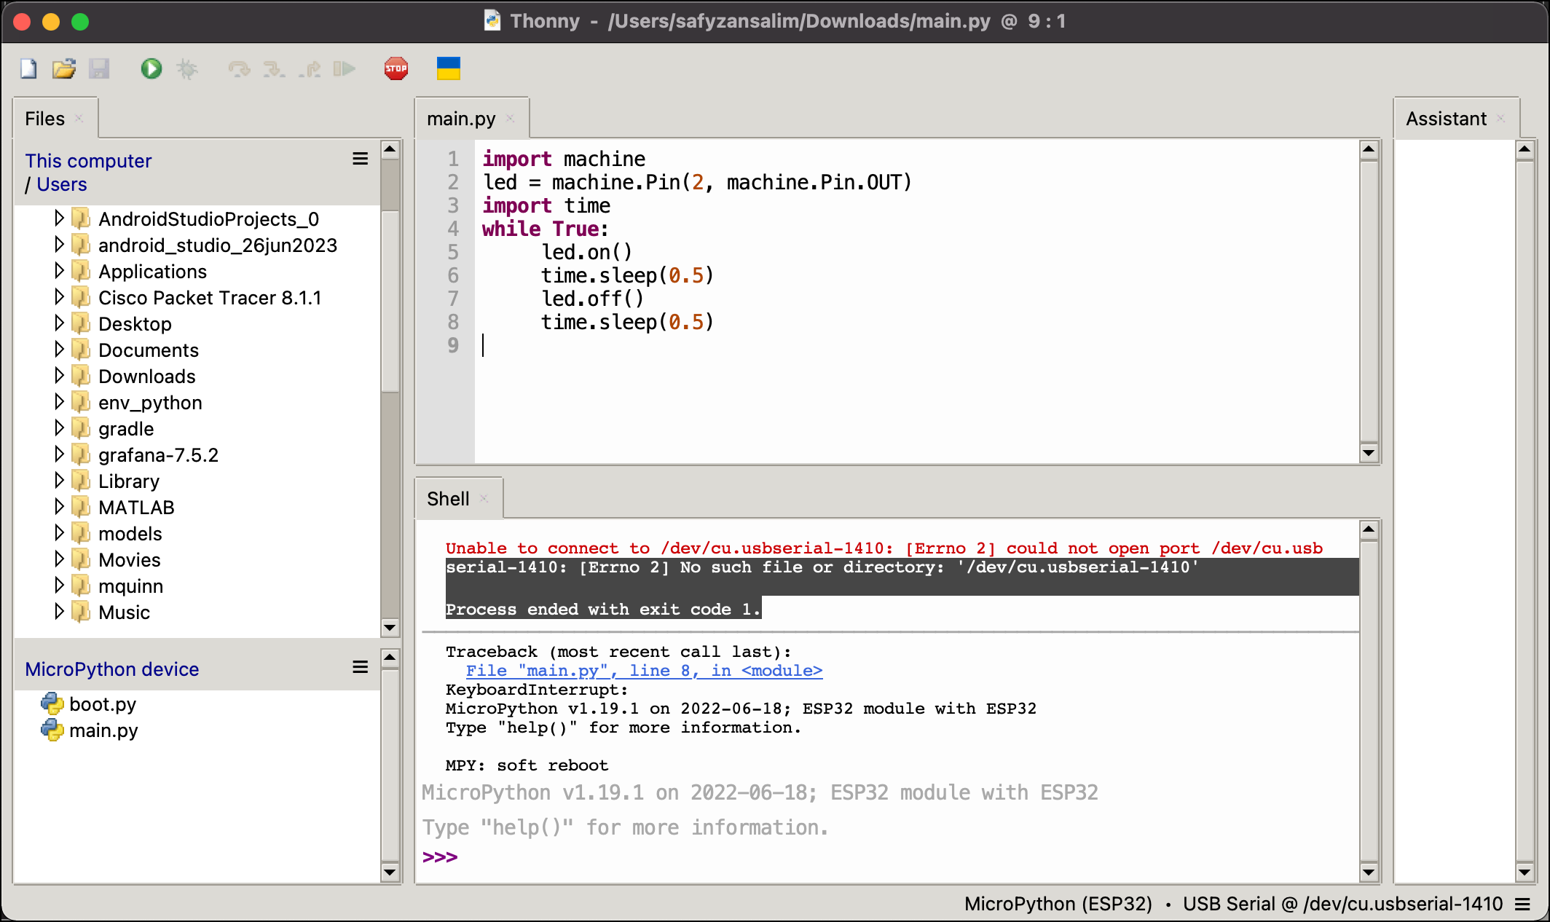
MicroPython + NodeMCU-ESP32S
2. Thonny Python IDE: Saving Your Works
Your laptop / PC
Your microcontroller
Rev01 Sept2023

Slide 24
MicroPython + NodeMCU-ESP32S
Remember:
1. Always ensure that the you have selected the right Comm Port to communicate with ESP32.
Tools>Option>Interpreter Tab
2. Only upload MicroPython firmware once, unless you have uploaded Arduino ESP32 firmware, then you have to click the Install or update MicroPython link.
3. Open Arduino IDE, select ESP32 board, its port & upload Arduino sketch as usual.
Rev01 Sept2023

Slide 25
MicroPython + NodeMCU-ESP32S
END
Rev01 Sept2023

